Slide 1


Code Challenge GIC ISPVMF Global Retreat 2017
Notes:
E1 - Good Morning, Welcome to the first day of the ISMPVMF retreat and an interesting segment – The programming challenge. I am <> and I am <>.
E2 – Are you sure you are in the right place – this is not a TD retreat, what is programming doing here? It’s ISPVMF retreat
E1 – Yes yes, I know it’s quite unusual, but this is very much for this fantastic group of ISPVMF.
You may think today’s session is a lesson on programming. But no, this is about playing a team game and challenging your colleagues to win some exciting prizes – and along the way picking up some useful programming skills. There is no programming skill or prior experience needed, and each one of us can participate. The basics of programming will be weaved into challenges through some fun tools, to expose the logic and analytical thinking process behind it.

Slide 2
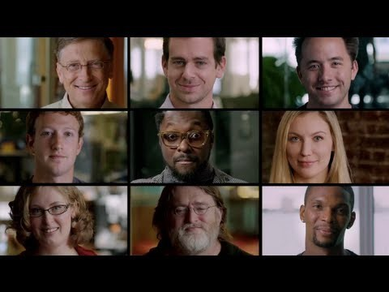
Yup, Everyone Can Code!
Notes:
(Pre-video) Now here’s a short video featuring people from diverse backgrounds like sports, musicians, CEOs, etc. sharing about programming.
(Post-video) This video demonstrates the simple point that everybody can and should learn programming. Today’s session is about giving you a start on this journey.

Slide 3
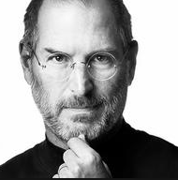
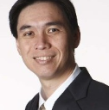
“
Everybody in this country should learn how to program a computer…because it teaches you how to think.
- Steve Jobs
”
“
The core skills that programing brings out in every one of us is logical/analytical thinking and the ability to solve problems in a creative manner.
- Hoe Yin
”
Notes:
The famous Steve Jobs once said:…
The equally famous personality in GIC circles has said….
So let’s look forward to a fun-filled session to gain some handy coding skills which has a potential to blossom into a core skill for you to be Future Ready in the tech-driven business model.

Slide 4

Aim
Basic
Introduction
To Coding
- Basic Python
- Web scraping
Most Importantly
Get to
Know
One
Another Better

Slide 5
Plans
Appetiser
11:15-11:30 - Introduction
11:30-12:30 - Baby Python
12:30-1:00 - Lunch Break
Main Course
1:00-1:30 – Say Hello to ReBot
1:30-2:30 – Taming the Python
2:30-4:00 – Rebot Challenge
4:00-4:30 – Short Break
Dessert
4:30-5:15 – Idea Generation and Pitch preparation
5:15-5:30 – Move to 38 Auditorium
5:30-6:15 – Pitch, Awards and Closing
Notes:
Here’s the agenda for today

Slide 6
Get Ready!

Slide 7
Why Code?
10 minutes
Notes:
Good morning Everyone.
I am <> and I am <>.
We are excited to be here with you and provide you a fun journey
Some of you may be

Slide 8




Notes:
RPA, automation, data
Not to turn everyone into programmers – basic understanding, possibilities
GIC use cases at the end

Slide 9
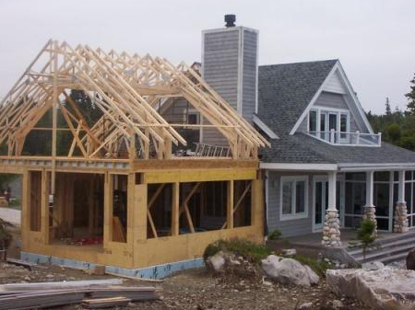
Notes:
Owner’s Mentality. Agile’s Project Owners
If someone wants to do renovation on your house, would you want to leave it with the person for 6 months? Or would you want to know exactly what the builder is going to change?

Slide 10
Stop. Think of Logical Blocks
Let’s get a computer to do things.
But,
The machine is a fast worker but very stupid
“Please, make me a sandwich!”
Will this work?
Step 1: Take a slice of bread, put it on the board
Step 2: Apply a 1mm layer of butter on the bread
Step 3: Take a slice of ham, put it on the bread
Probably closer to this,
Step 1: Move arm to coordinates (49, 50, 0) with power 1W
Step 2: Move arm down to (49, 50, -40) with power 1W
Step 3: Tighten fingers with power 2W
Notes:
Process of breaking down problems
Practice of breaking logic into a set of instructional processes
Improves logical thinking by breaking a problem into a set of

Slide 11
Python?
Uh.. Eating a snake?
45 minutes
Notes:
5 min - Opening vid
15 min: Intro & context
40 min: Scratch
30 min: Python
5 min: Code & Algorithms
15 min: Use Cases x2
5 min: Wrap up

Slide 12
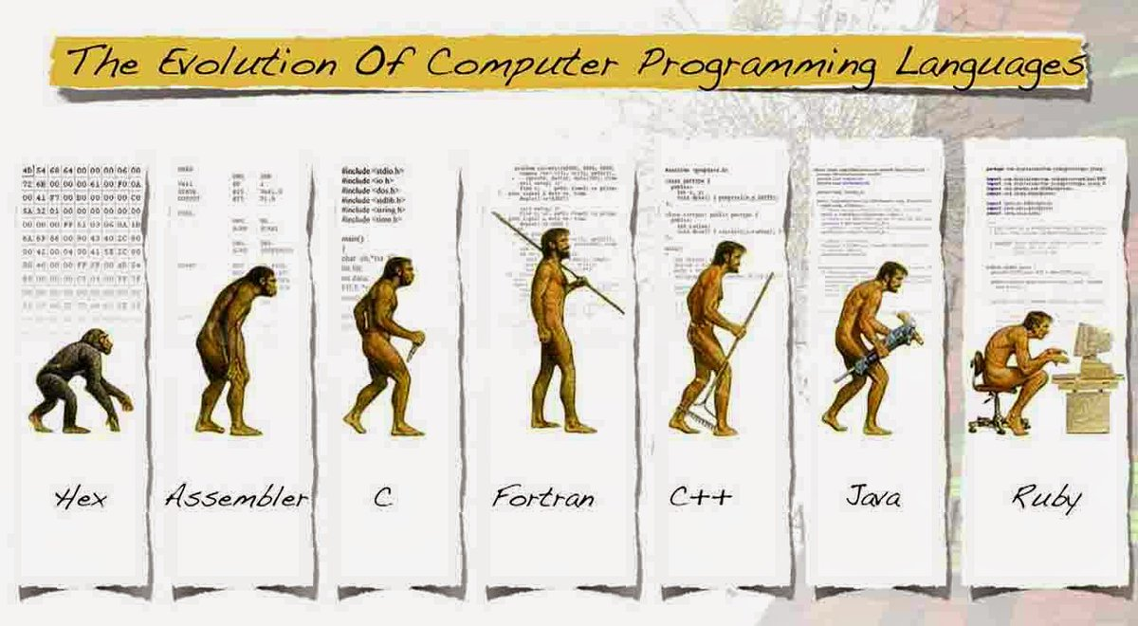
What Exactly is Python?
Considered a Fourth Generation Language
Simple & mighty for mathematical libraries
Relatively “natural” to read
Python!
Notes:
[Probably need a better picture for this]

Slide 13
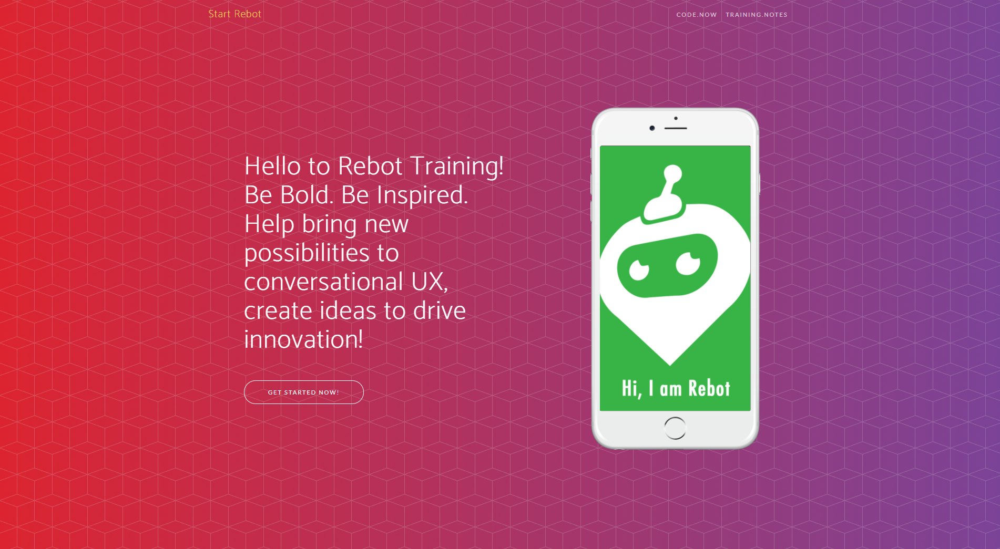
Visit Rebot.Chat
Type rebot.chat in your web browser

Slide 14
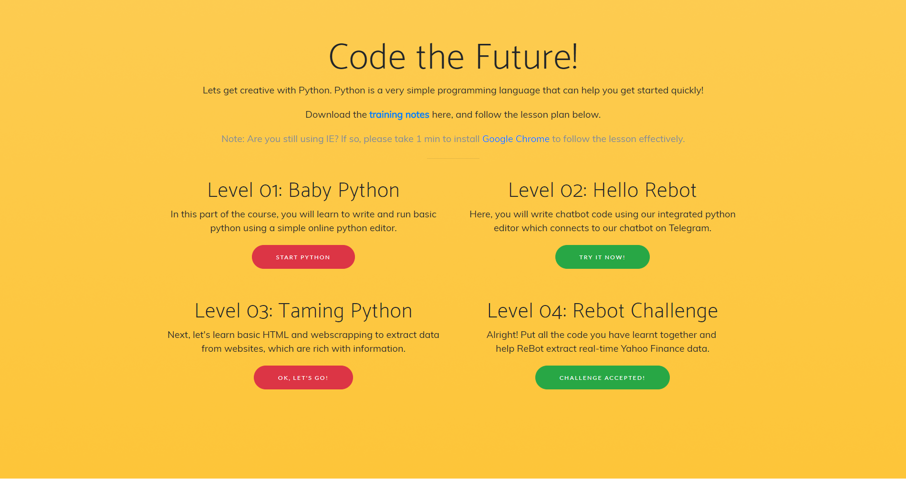
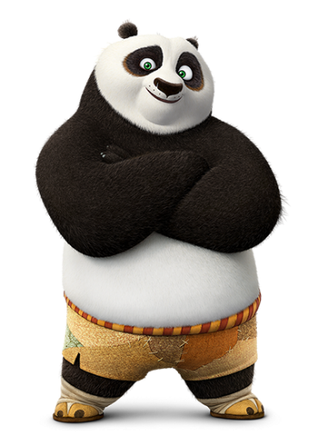

Slide 15
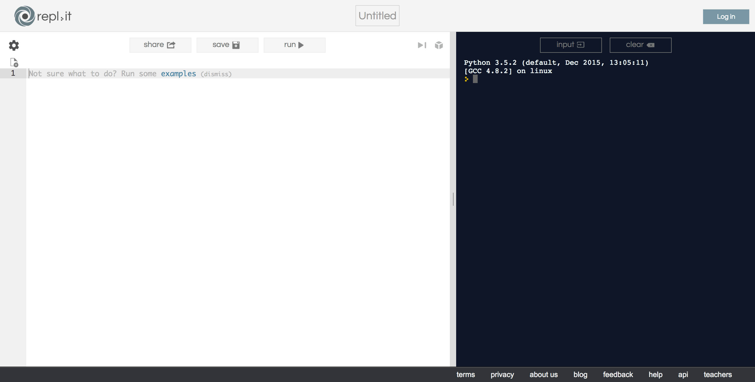
REPL: Basic Online Python Editor
(Left-Hand Side)
Write code here
(Right-Hand Side)
See output here
Notes:
Online editor

Slide 16
Real Code! Step-by-Step
Appetizer
Print “Hello World”
Explain concept of variables (containers)
Create a string variable “name”
Print “Hello, my name is …”
Main Course
Try addition, multiplication, division, subtraction
QN: what is 1 + 1?
Concept of variable types - integers, string etc.
Concept of (IF .. THEN .. ELSE)
Dessert
Recap + Free-to-play
Notes:
Hands-on session in Repl.It1. Hello World 2. print(1+2) 3. a=1 b=2 print(a+b)
then it's repl.it classes after that
which involves input(), multiplication, decimals
the last one involves integer-string conversion
"5" + "6" vs 5+6
int(input()) and so on

Slide 17
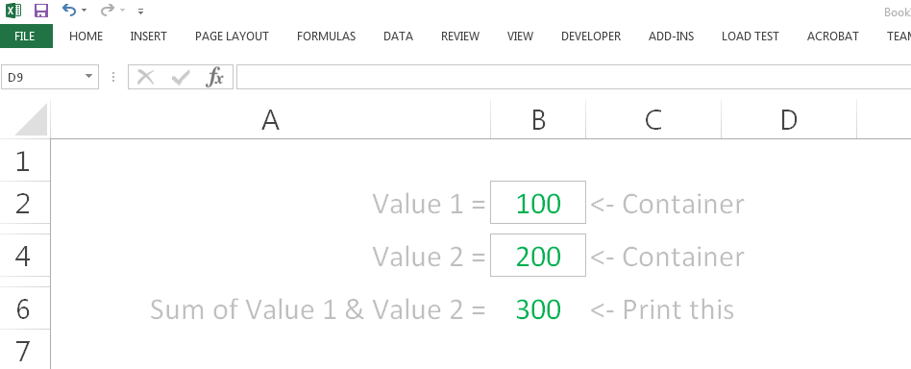
Hey wait, isn’t this familiar?
Excel Formulas
Describe outcome with expressions
Cell = IF(SUM(A:A) > 1, SUM(A:A), “No”)
Excel Worksheet Cells
Think of “Cells” like “Containers”
I am an Excel Worksheet

Slide 18
Logical Design >> Code
Coding easy to learn (And, can be fun ☺)
Writing a recipes: EASY
Creating a recipe: HARD
Given set of values: 5, 9, 10, 4, 11, 3, 6
Highest and lowest number?
What’s your recipe?
Don’t just translate your work procedures to code.
Simplify and refine it.

Slide 19

Golden Quotes
“
The core skills that programing brings out in every one of us is logical/analytical thinking and the ability to solve problems in a creative manner
- Hoe Yin
”
Notes:
The famous Steve Jobs once said:…
The equally famous personality in GIC circles has said….
So let’s look forward to a fun-filled session to gain some handy coding skills which has a potential to blossom into a core skill for you to be Future Ready in the tech-driven business model.

Slide 20
Lunch-Break
12.30pm – 1.00pm
30 minutes

Slide 21
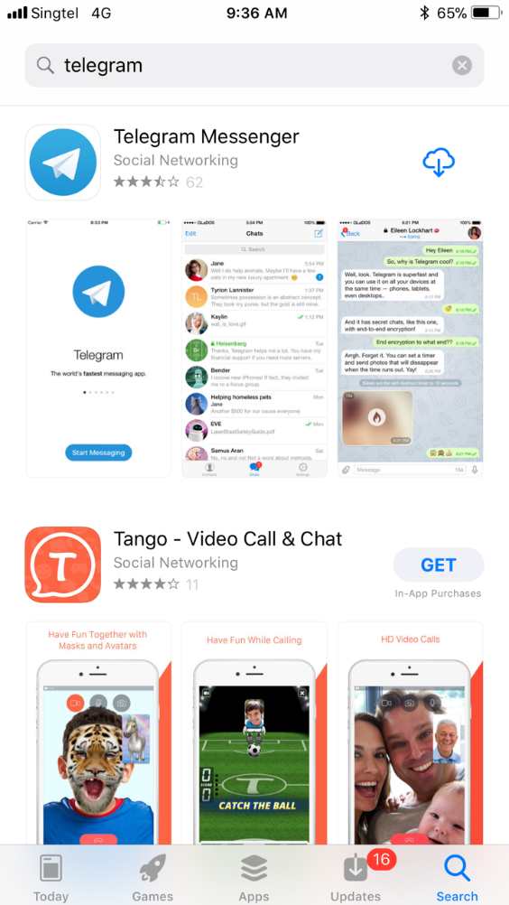





Step 1: Install Telegram

Slide 22
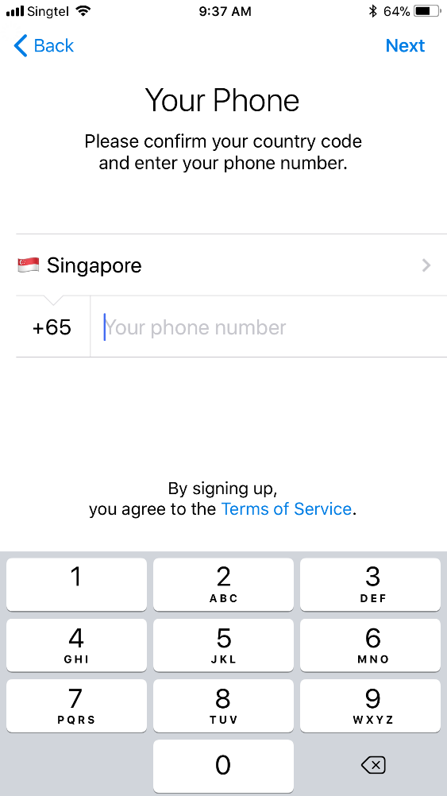
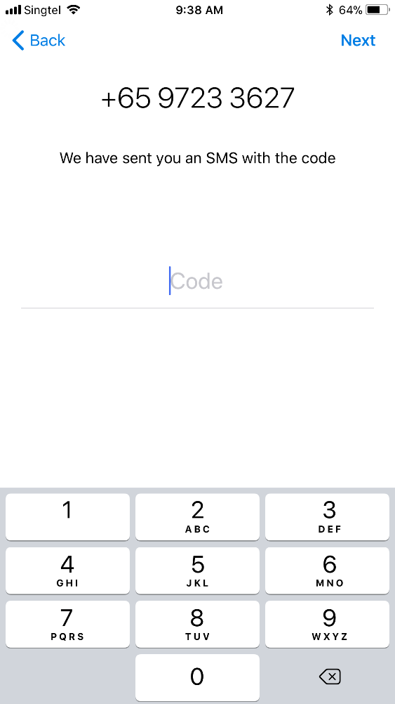
Step 2: Register Account
Register for an account
Wait for an SMS passcode
Key in the passcode
Your Phone Number

Slide 23
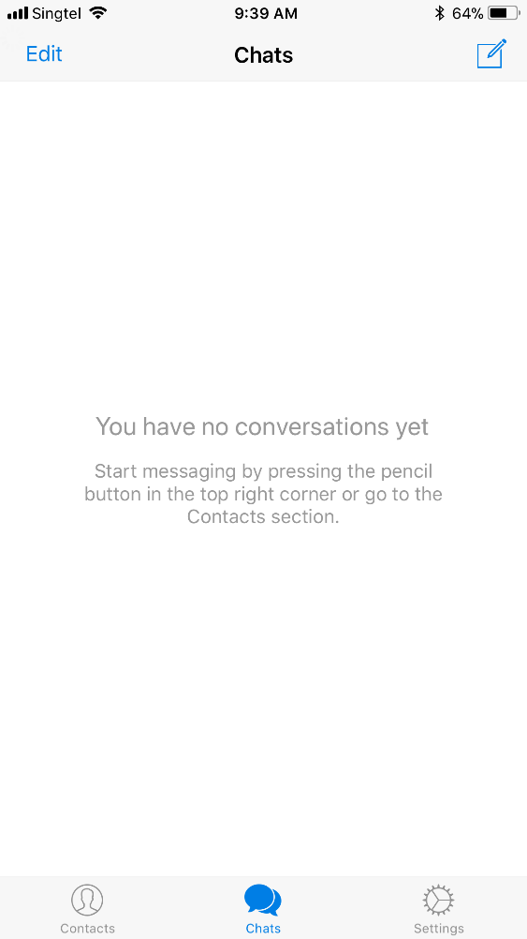
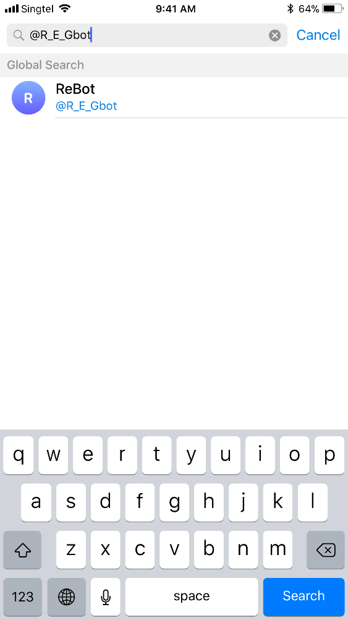
Step 3: Add @ISPVMF_ReBot
Add a Chat
Search for @ISPVMF_Rebot
Select @ISPVMF_Rebot

Slide 24

Rebot
Putting it Together For the First Time
30 minutes

Slide 25
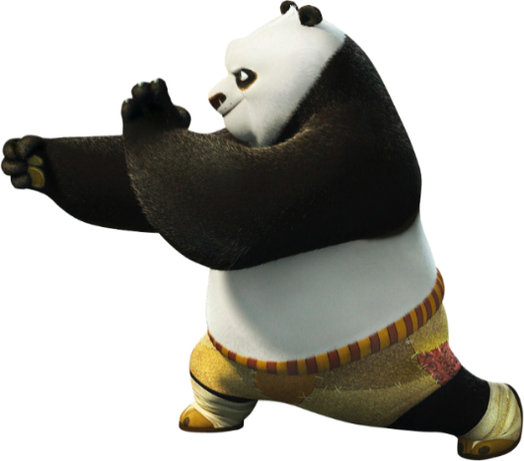

Slide 26
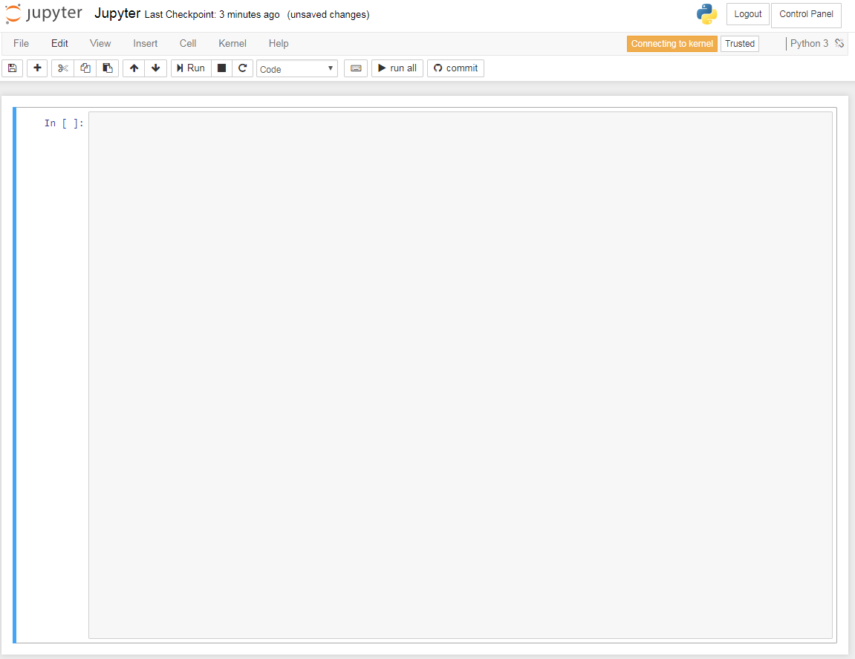
Jupyter: Integrated Python Editor
Jupyter is integrated
with @ISPVMF_ReBot
on Telegram
Next, lets see how your code changes on Jupyter
appear magically on your mobile phone

Slide 27
Let the Magic Happen
Appetizer
Return “Hello World”
Return “Your Name”
Main Course
Lets make our chat bot smarter.
Return Sum (1 + 1)
Return (IF .. THEN .. ELSE)
Dessert
Return random results.
What is the day today?
What is your name?
I am bored?
Notes:
Give roles – product owner, tester, developer

Slide 28
Web-scraping
Scraping Data From HTML
60 minutes
Notes:
5 min - Opening vid
15 min: Intro & context
40 min: Scratch
30 min: Python
5 min: Code & Algorithms
15 min: Use Cases x2
5 min: Wrap up

Slide 29
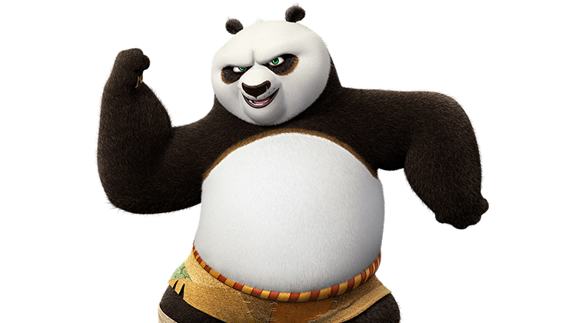

Slide 30

What is HTML?
HTML is
The building block of websites.
Source code of the Web
Concept of HTML Tags
Open tags <HTML>
Close tags </HTML>
Let’s see how to scrap data from HTML
HTML

Slide 31
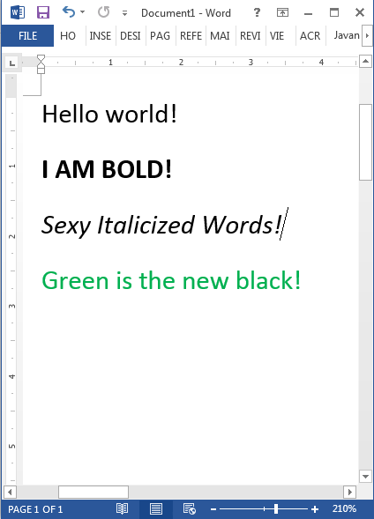
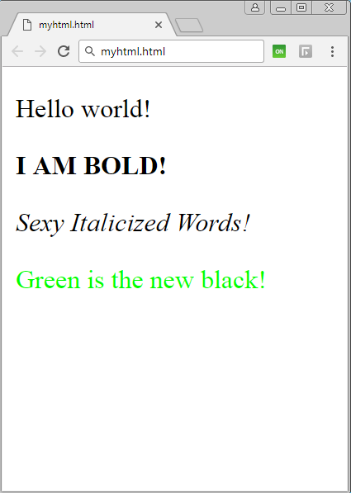
Word Doc vs HTML Doc
Word Document
HTML Document

Slide 32
Word Doc vs HTML Doc
Word Document
HTML Document

Slide 33
HTML - Code Visualization
HTML - NESTED CONTAINERS
HTML - CODE BLOCKS
HTML - RAW CODE
Container (HTML)
<HTML>
</HTML>
<HTML>
<BODY>
<P CLASS=“Text”>
Hello World! </P>
</BODY>
</HTML>
Container (BODY)
<BODY>
</BODY>
Container (P)
<P CLASS=“Text”>
Hello World!
</P>
These values are enclosed in tags (think of containers).
They are the basic building blocks needed used to build basic to complex websites.
Notes:
We are just going to learn some basic tags
Built piecemeal

Slide 34
Word Doc vs HTML Doc
Word Document
HTML Document

Slide 35
Word Doc vs HTML Doc
Hey! HTML is just made up of TAGs
<html>
<body>
<p>
<p>
<p>
<p>
</body>
</html>
</p>
</p>
</p>
</p>
Hello World!
<b>I AM BOLD!</b>
<i>Sexy Italicized Words!</i>
<font color=“green”>Green is the new black!</font>

Slide 36
Think of Tags as Containers
Think of a
HTML TAG
As a
CONTAINER
I AM A VALUE

Slide 37
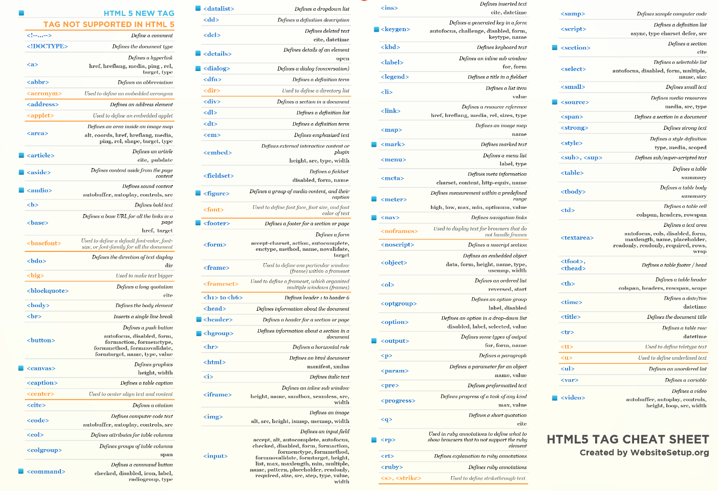
So many types of HTML tags…
For
Illustration Purposes Only

Slide 38
Useful Tags for Today
<html>
<body>
<p>
<span>
<td>
<div>
</html>
</body>
</p>
</span>
</td>
</div>

Slide 39
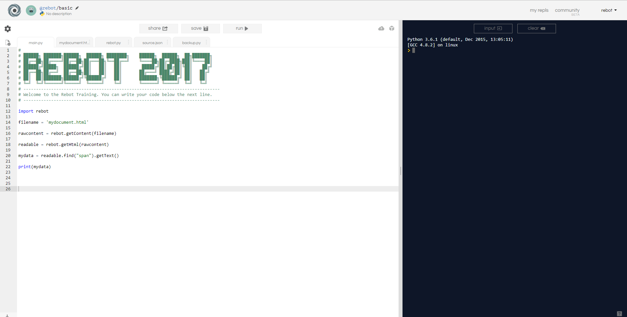
Hands On
data = readable.find("span", {"class": "target"}).getText()

Slide 40
Hands On
Step 1: Import libraries
Coders in the community can create libraries of commonly used features. These templates are pre-defined and can help us simplify and reuse code.
Step 2: What is the document filename? For example. “Quarterly reporting.doc”, “Mydocument.html”, http://rebot.chat/index.html.
Step 3: Get the raw content within the document
Extract the file content as bytecode literals directly from the document.
Step 4: Format the content into a readable format
Creates a clean HTML format of the raw content, which is then readable by the extraction logic.
Step 5: Find the data-point we need
Use the library to search for the container that we need, including any specific class properties into the search criteria
Notes:
Now you have a lot of containers. How do you find the container that contains the data point that you want.
For this exercise, we will be using a class as attribute identifier
Library – there are a lot of ppl developers out there that have created reusable libraries that simply things we commonly do.
Template that we can reuse for our coding. That have been predefined. For this programming, are importing two libraries.

Slide 41
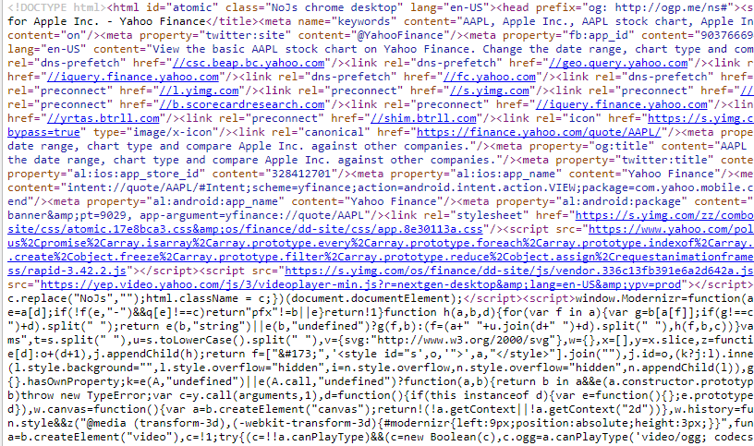
Often, its not so easy..
Example: HTML code behind Yahoo.com

Slide 42
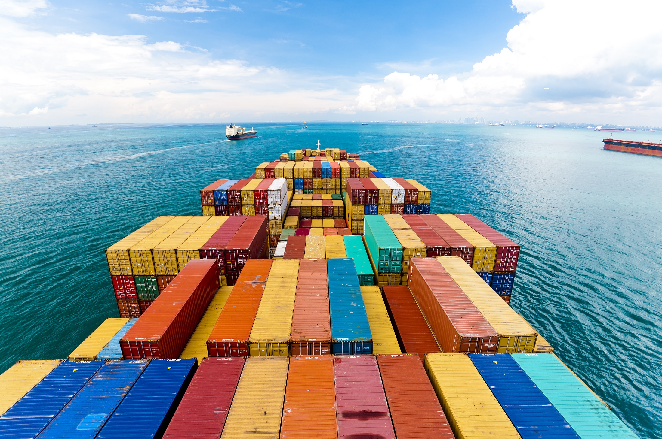
Often, its not so easy..
HOW TO FIND A CONTAINER LIKE DAT?
Notes:
Now you have a lot of containers. How do you find the container that contains the data point that you want.
For this exercise, we will be using a class as attribute identifier
Library – there are a lot of ppl developers out there that have created reusable libraries that simply things we commonly do.
Template that we can reuse for our coding. That have been predefined. For this programming, are importing two libraries.

Slide 43
Nesting of Data
Geography
Websites
Country
Html
City
Body
Town
Table
Street
TD (Table Data)
Block
Span

Slide 44
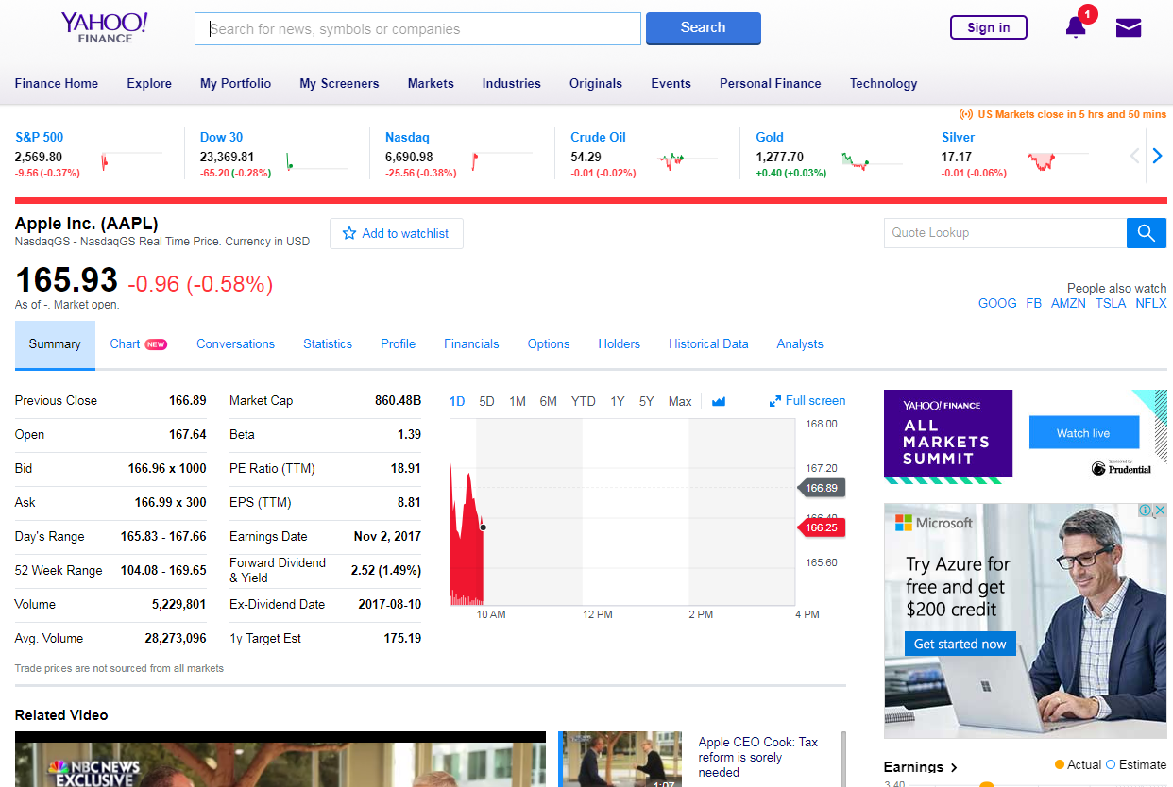
Nesting of Data: Example Yahoo

Slide 45
Challenge
Scraping Real Data from Websites
90 minutes

Slide 46
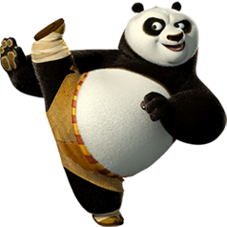

Slide 47

Challenge Rules!
Earn as many gold coins as possible by completing challenges!
Spend your gold coins effectively to finish your challenges quickly!
*Note: Challenges must be completed in sequence
x 2 : Challenge 1
x 3 : Challenge 2
x 4 : Challenge 3
x 5 : Challenge 4
Free : Use training materials
x 1 : Seeking help from another sub-team
x 2 : Ask facilitators

Slide 48
Prizes
Overall Best Team
Techie Masters
The group with the most number of gold coins
Overall Best Sub-Team
Techie Buddies
The sub-team with the most number of gold coins
Overall Best Coder
Tech Guru
Decided by the TD Emcees and Game Master

Slide 49
HTML - Code Visualization
HTML - NESTED CONTAINERS
HTML - CODE BLOCKS
HTML - RAW CODE
Container (HTML)
<HTML>
</HTML>
<HTML>
<BODY>
<P CLASS=“Text”>
Hello World! </P>
</BODY>
</HTML>
Container (BODY)
<BODY>
</BODY>
Container (P)
<P CLASS=“Text”>
Hello World!
</P>
These values are enclosed in tags (think of containers).
They are the basic building blocks needed used to build basic to complex websites.
data = readable.find("p", {"class": "text"}).getText()
Notes:
We are just going to learn some basic tags
Built piecemeal

Slide 50
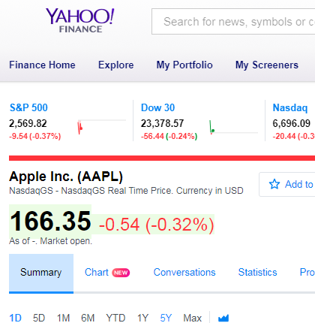
Example 1
<h1
class="D(ib) Fz(18px)"
data-reactid="7">
Apple Inc. (AAPL)
</h1>
Solution:
data = readable.find("h1", {"class": "D(ib) Fz(18px)"}).getText()

Slide 51
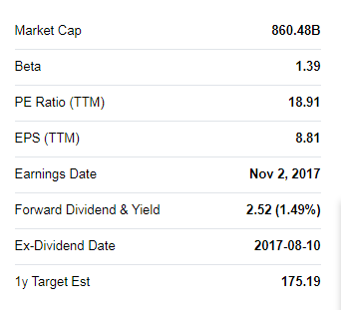
Example 2
<td
class="Ta(end) Fw(b) Lh(14px)"
data-test="BETA-value"
data-reactid="89">
<span
class="Trsdu(0.3s) "
data-reactid="90">
<!-- react-text: 91 -->1.39<!-- /react-text -->
</span>
</td>
Solution:
data = readable.find("td", {"data-test": "BETA-value"}).getText()

Slide 53
Resources
Notes:
5 min - Opening vid
15 min: Intro & context
40 min: Scratch
30 min: Python
5 min: Code & Algorithms
15 min: Use Cases x2
5 min: Wrap up

Slide 54
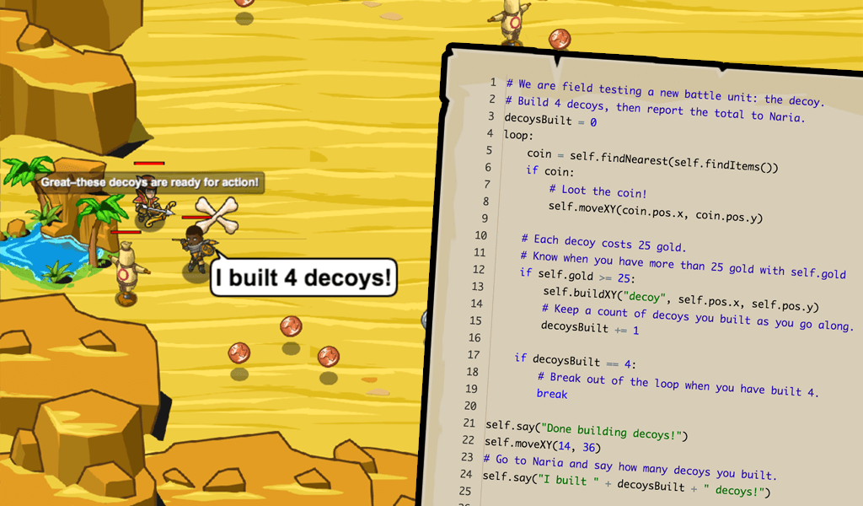
CodeCombat.com
CodeCombat is a fun browser-based coding game that teaches programming. In order to advance through the game's levels, players must prove their knowledge by writing code.

Slide 55
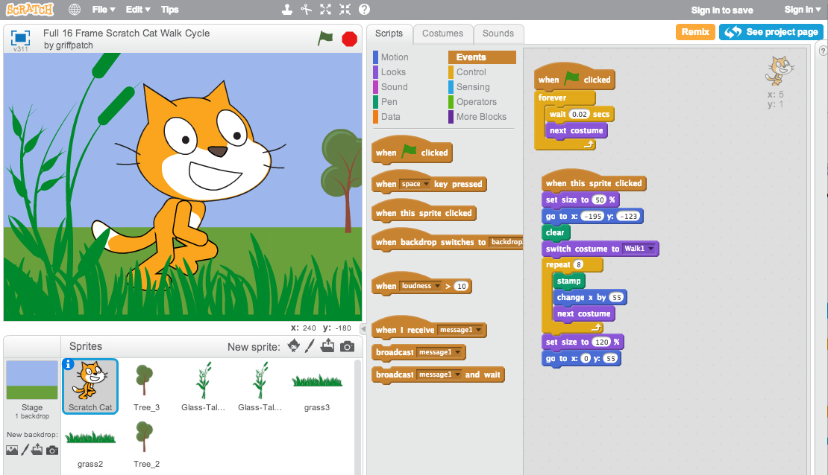
Scratch.mit.edu
Scratch was created by MIT to help people learn to think creatively, reason systematically and work collaboratively. You can use it to create and publish interactive stories, animations, games!

Slide 56
Pitch Perfect
Notes:
5 min - Opening vid
15 min: Intro & context
40 min: Scratch
30 min: Python
5 min: Code & Algorithms
15 min: Use Cases x2
5 min: Wrap up

Slide 57

Notes:
Some broad ideas
7 groups of 6 - 10min
Pitch - 3 x 7 mins - 25min
Choose best 2 ideas – 10min

Slide 58
Wifi-Access
SSID
ISPVMF_RETREAT_2017
PASSWORD
ISPVMF_2017

